Slide 1

Corporate Briefing Session 2025
Tuesday, November 25, 2025 at 10:30 AM

Slide 2
Table of Contents
Company Brief
Strategic and Operational Developments
Governance
Management of the Company
Shareholding Structure
Product Briefcase
Product Innovation and Digitalization
Financial Highlights
Premium Analysis
Business Alliance
Future Outlook
Q & A

Slide 3
About Us – Askari Life Assurance Co. Ltd
Askari Life Assurance Company Limited is part of one of the leading conglomerates in Pakistan, Army Welfare Trust (AWT)
Is a public limited company licensed in 1992 and listed on Pakistan Stock Exchange (PSX)
Majority shareholding acquired by AWT in 2017
Dynamic leadership with in depth knowledge of insurance and financial service industry
Company has a fund size of approx. Rs. 3 Billion and backing of top reinsurers of the world like Munich Re and Hannover Re
Awarded A IFS Rating (long term with stable outlook) by PACRA
Authorized capital of Askari Life is Rs. 3 billion
Regulated by SECP and fully compliant with COCG regulation for Public Limited Company

Slide 4
Our Strategic Roadmap
Market-Leading Products Extensive Distribution Network Valued Corporate Partnerships Digital Transformation

Slide 5
Company Governance

Slide 6
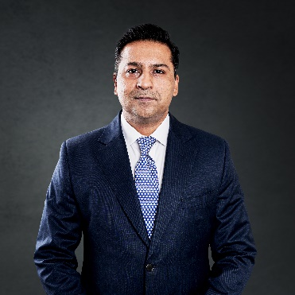
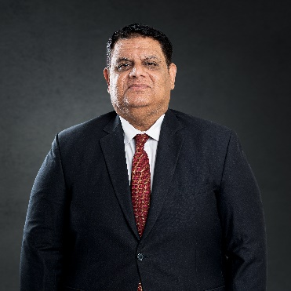
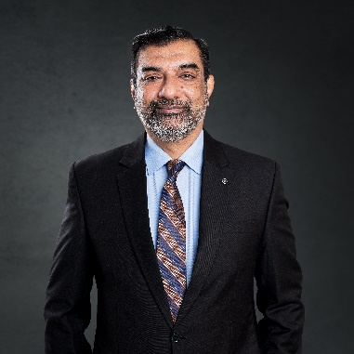
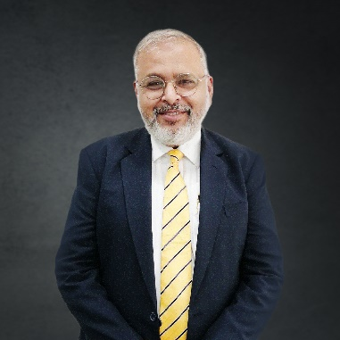
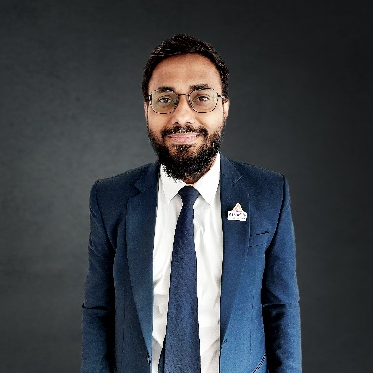
Askari Life Management Team
Founding member and CEO of Askari Life, a dynamic leader with expertise in the insurance and financial services industry. Responsible for take over and turnaround of Askari Life by developing strong product lines and expansive distribution by creating winning partnerships. Previously, as Chief Strategy Officer at Adamjee Life Assurance
Co. Ltd., he crafted key distribution and organizational strategies. He holds an MBA from City University London and a strategy certification from Harvard Business School.
Jehanzeb Zafar
Chief Executive Officer
Rehan Mobin
Chief Financial Officer
Mohammad Azmatullah Sharif
Chief Operating Officer
Syed Ali Imran
Head of Distribution
Waqas Waseem
Head of HR & Administration
He is a qualified CPA from USA and FCA from Institute of Chartered Accountants of Pakistan, having around 18 years experience in insurance industry both in and outside of Pakistan.
He holds a portfolio of extensive experience in the areas of Actuarial, Operations and People Management, both in the local as well as international markets. In addition to this he is a Fellow of Society of Actuaries.
.
A qualified Life Insurance Professional, who served in various financial sector of Pakistan for more then last 30 years. Have extensive experience of People Management, Sales and Marketing.
He is an MBA with a specialization in HRM. In addition, he has completed his L.L.B. with a specialization in labor & employment laws.
Has over 15 years of multi-facet and rigorous experience in Human Resource Management.

Slide 7
Shareholding Structure

Slide 8
Askari Life’s Products & Propositions in the Market
Agency Distribution
Regular Premium Products Conventional Askari Nayab Plan: A universal life standard plan to cater for the savings-oriented mass market. Askari Zarkhez Plan: A universal life plan for the HNW customer base. Takaful Kanz Ul Askari Family Takaful Plan: A Family Takaful plan to cater for the mid tier market. Iqra Family Takaful Plan: A Family Takaful investment plan to cater for child’s educational needs of the customers.

Slide 9
Askari Life’s Products & Propositions in the Market
Agency Distribution
Regular Premium Products (Cont…) Surbuland Family Takaful Plan: A Family Takaful investment plan to cater for savings needs of the customers. Pursukoon Kal Family Takaful Plan: A Family Takaful investment plan where retirement needs are fulfilled for the customers. Humrahi Family Takaful Plan: A Family Takaful investment plan to cater for the financial needs of young couples. Askari Life Muhafiz Family Takaful Plan (for the Armed Forces Personnel): A Family Takaful investment plan specially designed for Armed Forces of Pakistan. Askari Life Golden Path Takaful Plan: High Net Worth Takaful Plan with quick cash value build up and bonuses

Slide 10
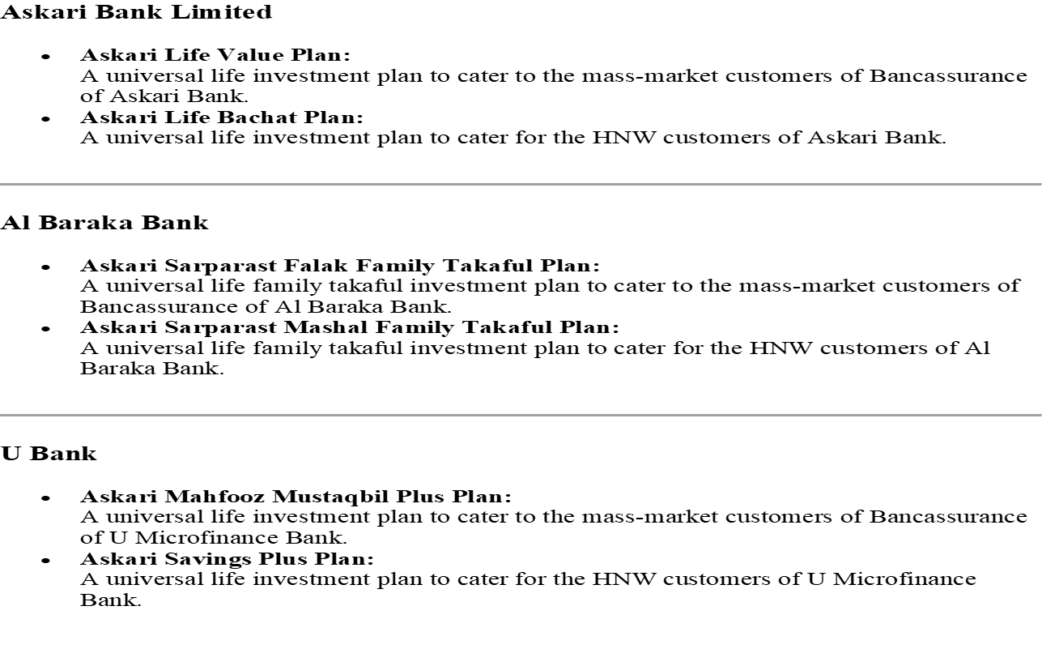
Askari Life’s Products & Propositions in the Market
Bancassurance Distribution

Slide 11
Product Innovation and Digitalization
Askari Life strongly believes that innovative products and technological acumen are the key of success in the competitive environment of life insurance
Individual Life savings products having diversity of Conventional and Shariah Compliant Takaful Products
Third party online portals and other digital channels are being introduced, which will allow Askari Life to sell and service the products through internet
Facilitate customers and other stakeholders by online payment and receipt system that connects with Finance and Operations Department.

Slide 12
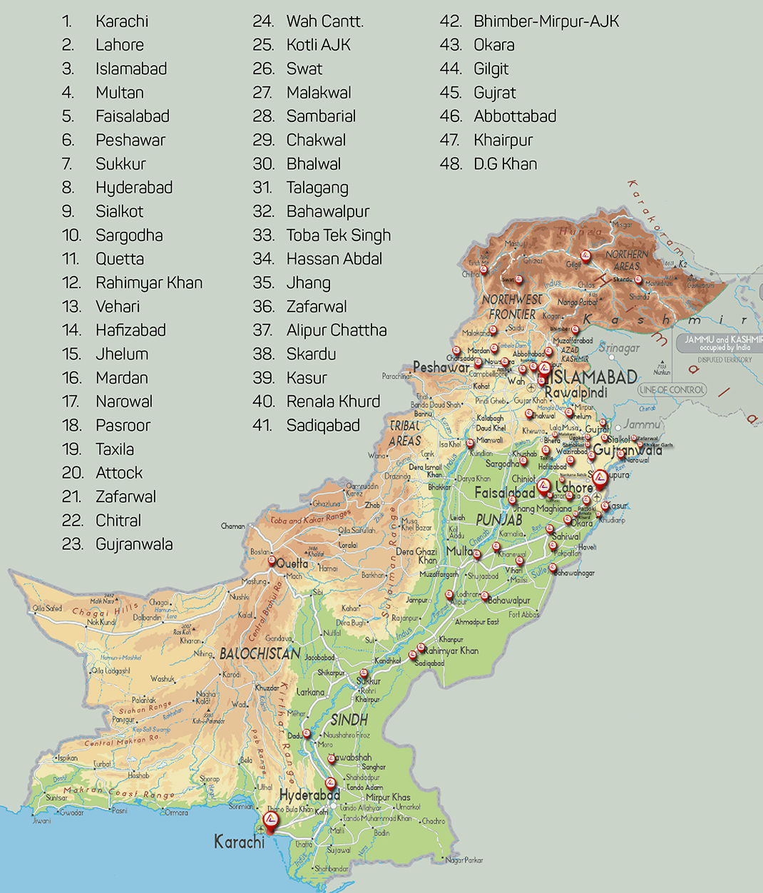




Askari Life Assurance – Distribution Network and Corporate Clients
1. Agency Distribution
Establish direct distribution low-cost Agency Model by partnering with top notch insurance sales leadership. No salaries, vehicles, branch network and related costs. From sales team of 180 with 3 branches to 2600 sales team operating from 80+ locations in less than 1 year.
2. Muhafiz Savings Plan
Retirement Savings plan with comprehensive Takaful coverage for member of armed forces
Dedicated Sales team with low-cost service centers to tap this sizeable opportunity unique to Askari Life
3. Bancassurance Distribution Partners
Askari Bank | Bank Al Baraka | U Micro Finance Bank
4. Corporate Clients
Working with a number of prestigious employers providing protection to their employees and families, including FF, TCS, Telenor, AWT Group, Shaikh Zayad Hospital, and Askari Bank.
5. Product Offering
Individual Life Savings Plans - Child Education, Daughter Marriage, Retirement and Housebuilding/Hajj savings
Group Life Insurance - For employees and customers of corporate clients (TCS, Telenor, FF, AKBL, FCCL)

Slide 13
Key Statistics of Askari Life Assurance
Sep. 2025 | Sep. 2024
2,196,376 | 1,253,047
Covered Persons
Amount of Claims Paid
290K+
Rs 627.69 million in 2024

Slide 14
Financial Highlights

Slide 15
Premium Analysis

Slide 16
Future Outlook
Challenges
  High taxes and depleting disposable income
  Regulatory Compliance ( AML & CFT).
  Taxation on Saving Products
  Lack of Awareness about insurance products
Strategy
  Effectively trained Sales Force
  Technology driven business operations
  Target the unapproached segment
  Marketing Alliances and Customer engagement
  Product innovation

Slide 17
Question and Answer

Slide 18
Thank You

